Slide 1
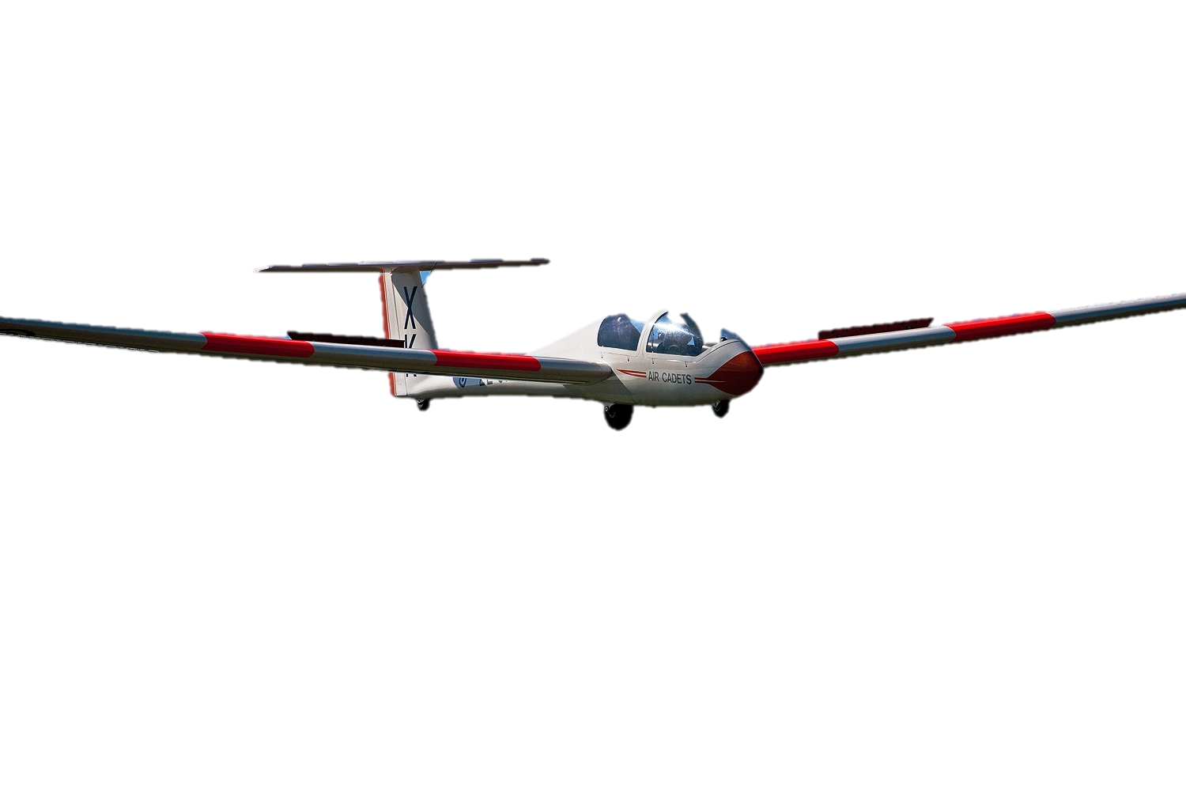
Fundamental Principles of Airmanship
Learning Outcome 3 (Part): Know the Features and Types of Aircraft Used for Air Cadet Flying
Version 2 (May 19)

Slide 2
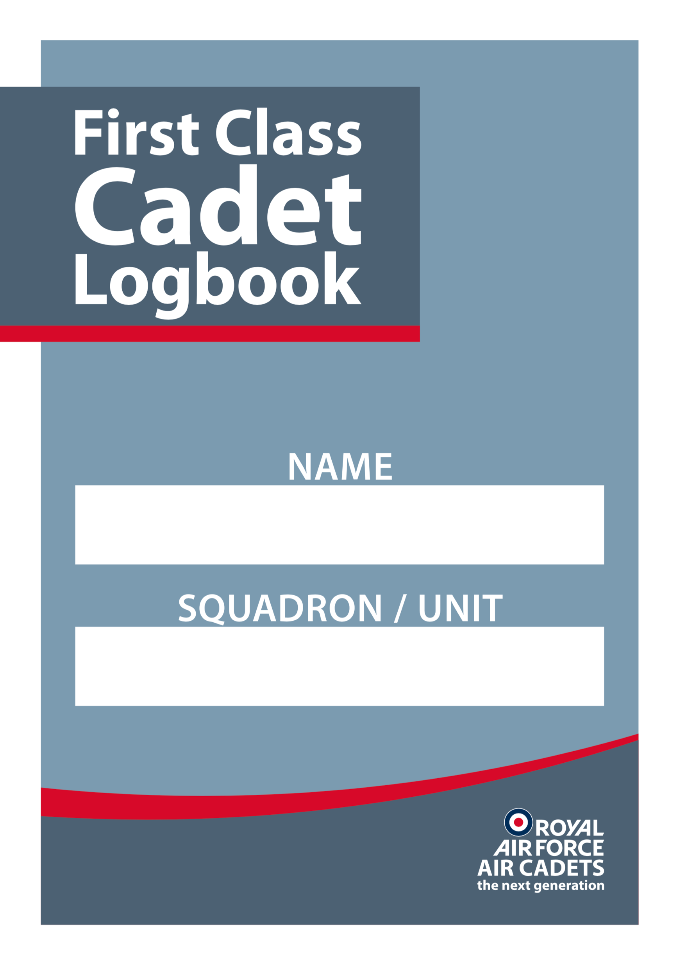
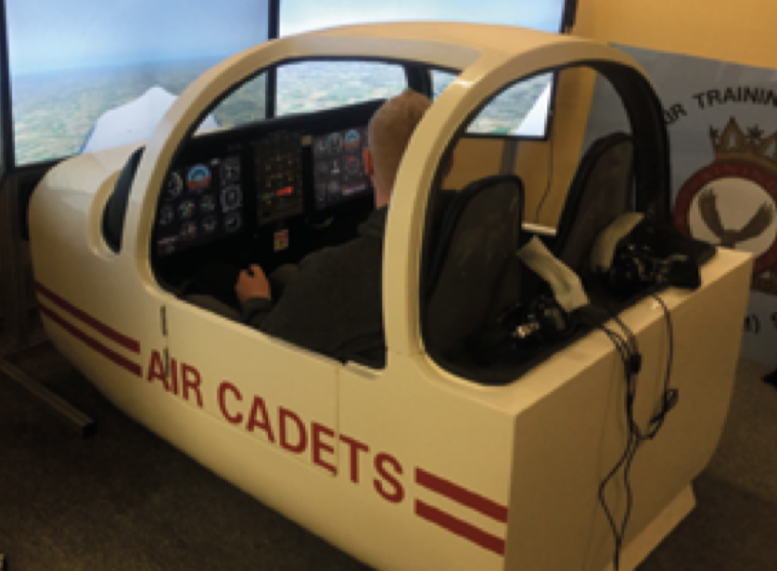
Practical Activities
Undertake the practical activities found in Ultilearn and record their completion in the First Class Cadet Logbook.
and
Demonstrate and practice on a flight simulator, if you have one.

Slide 3
Types of aircraft

Slide 4
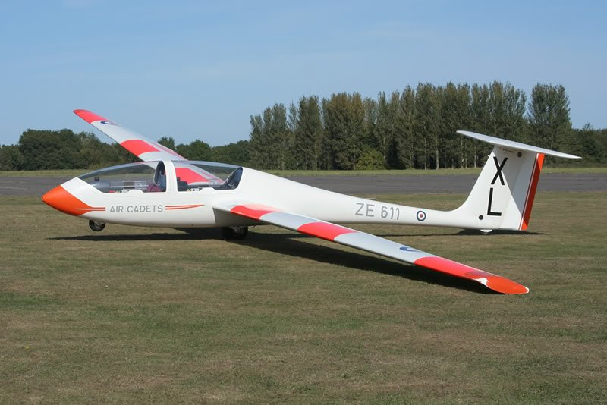
Viking T1
PASS
The Grob G103A Twin II Acro, known by the RAF as the Viking T1
Used by the RAF Air Cadets to give basic gliding training
Used by the Volunteer Gliding Squadrons
Two seat tandem with dual controls
Normally winch-launched but can be aero-towed

Slide 5
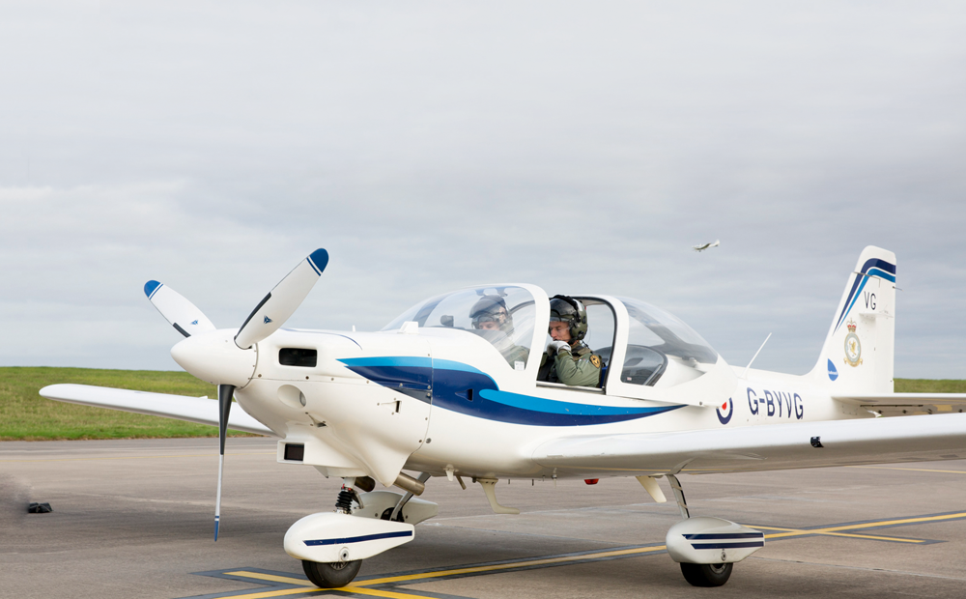
Grob Tutor
PASS
Grob 115 (Tutor) T1
Primary trainer used for AEF and for elementary flying training by the UAS and RAF
Single engine, fixed wing monoplane
Two seat side-by-side with dual controls

Slide 6
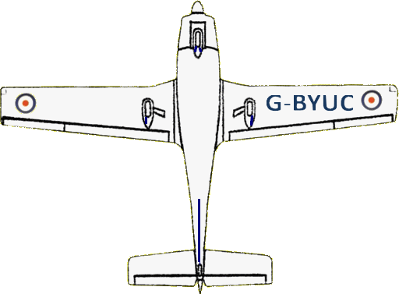
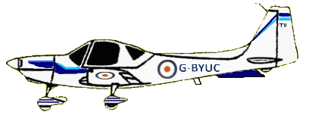
PASS
Grob Tutor 115
Wingspan: 10.0m
Length: 7.6m
Height: 2.8m
Max Weight: 990Kg
Engine: 180hp
Max Speed: 185 knots
Side-by-side 2 seat tandem
Carbon Fibre construction

Slide 7
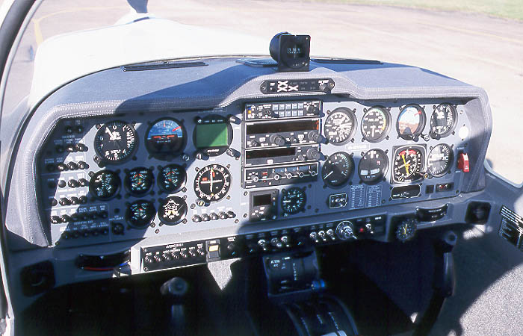
Cockpit Layout
PASS
Notes:
General Cockpit Layout
The cockpit of the Tutor is simple compared with that of modern operational aircraft. Nevertheless there will be much in it that will be strange to you at first. Terms you need to know are “instruments”, which indicate what the aircraft is doing and “controls,” which are used to manoeuvre the aircraft.
Two radios provide both air-to-ground and air-to-air communication. One operates within the UHF band and one within the VHF band. It is important that cadet passengers do not interfere with any of the settings on the radio control boxes Engine Instruments and Controls. There are several instruments associated with the engine, the two most important are grouped on the left side of the flying instruments. There are also 3 controls for adjusting the engine performance mounted on the centre console.
Engine Instruments
RPM. The rpm gauge shows the speed at which the engine is rotating in revolutions per minute (rpm). The reading “20” gives 2,000 rpm.
Manifold Pressure (MP). This instrument gives an indication of how much power is being supplied by the engine, it responds to throttle movements and is calibrated in inches of mercury (it is the pressure in the engine inlet manifold).
Temperatures and Pressures. Two small instruments under the left (secondary) Attitude Indicator show various temperatures (in degrees Celsius) and pressures (in pounds per square inch – psi) within the engine.
Engine Controls
Throttle. The throttle lever is on the centre console. If pushed forward (opened), it increases the engine output – rather like the accelerator pedal on a car.
RPM Control. The RPM control is a blue lever to the right of the throttle, it enables the pilot to adjust the RPM of the engine and hence the efficiency of the propeller.
Mixture Control. The mixture control lever is the red lever next to the RPM control. It enables the pilot to adjust the fuel/air ratio of the mixture going into the engine

Slide 8
Aircraft instruments
How to tell what an aeroplane is doing when in the air…

Slide 9
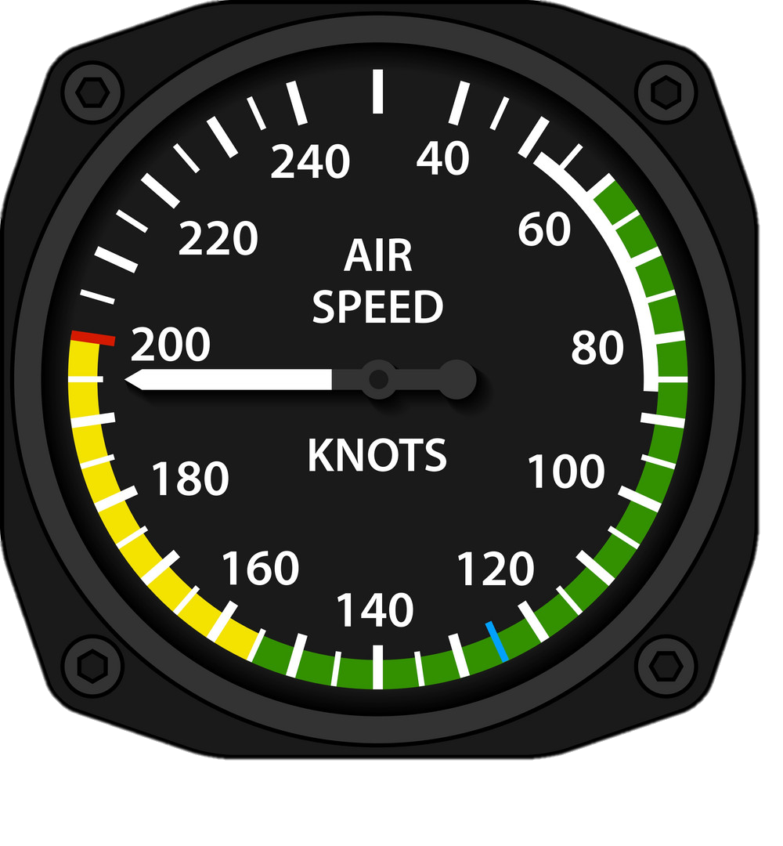
Airspeed Indicator
MERIT
Shows the pilot the speed of the aircraft through the air,
measured in knots
Assists the pilot in ensuring a stall does not occur
Helps the pilot keep a safe and constant speed
Essential when navigating!

Slide 10
Artificial Horizon Indicator
MERIT
Used to inform the pilot of the orientation of the aircraft relative to Earth's horizon
It indicates:
pitch (fore and aft tilt)
bank or roll (side to side tilt)

Slide 11
Vertical Speed Indicator
MERIT
Also called a Variometer
Used to inform the pilot of the rate of descent or climb of the aircraft
Is useful to help maintain level flight, especially during turning manoeuvres

Slide 12
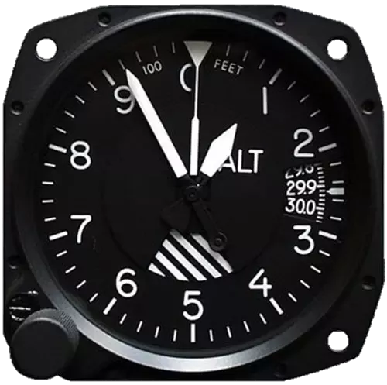
Altimeter
MERIT
The big hand of the altimeter is the height in thousands, the one in the middle is the altitude in hundreds, the smallest one goes from 1 to 100
An instrument used to measure the altitude or height of an aircraft
Measured in feet
The pressure against which the altitude is being read is in the right hand window – this is changed by using the knob on the left
This altimeter is reading 920 feet above sea level

Slide 13
Controls and planes of movement
How an aeroplane is controlled…

Slide 14
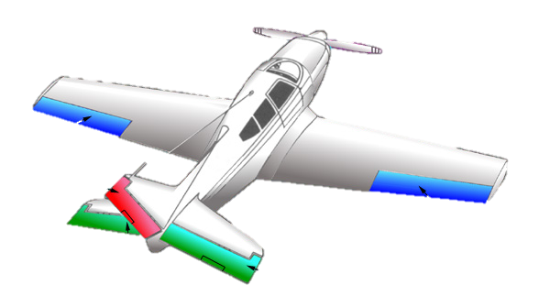
Control Surfaces on an Aircraft
PASS
Aileron
Rudder
Aileron
Elevator

Slide 15
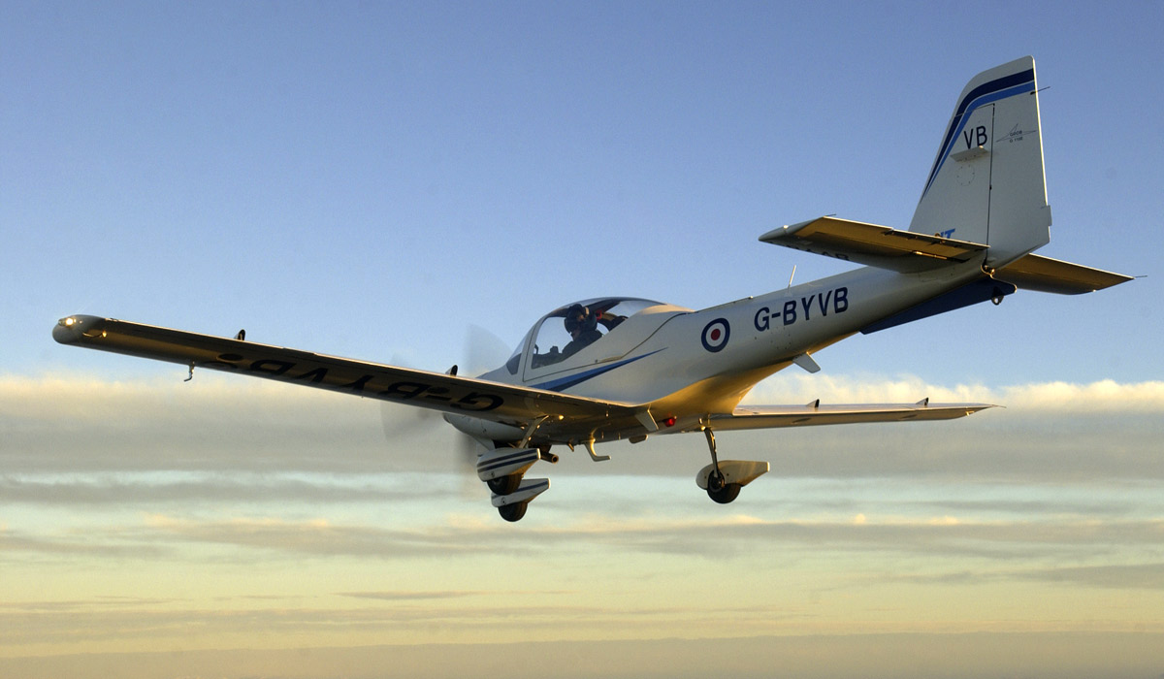
Control Surfaces – what do they look like in real life?
PASS
Rudder
Aileron
Elevator

Slide 16
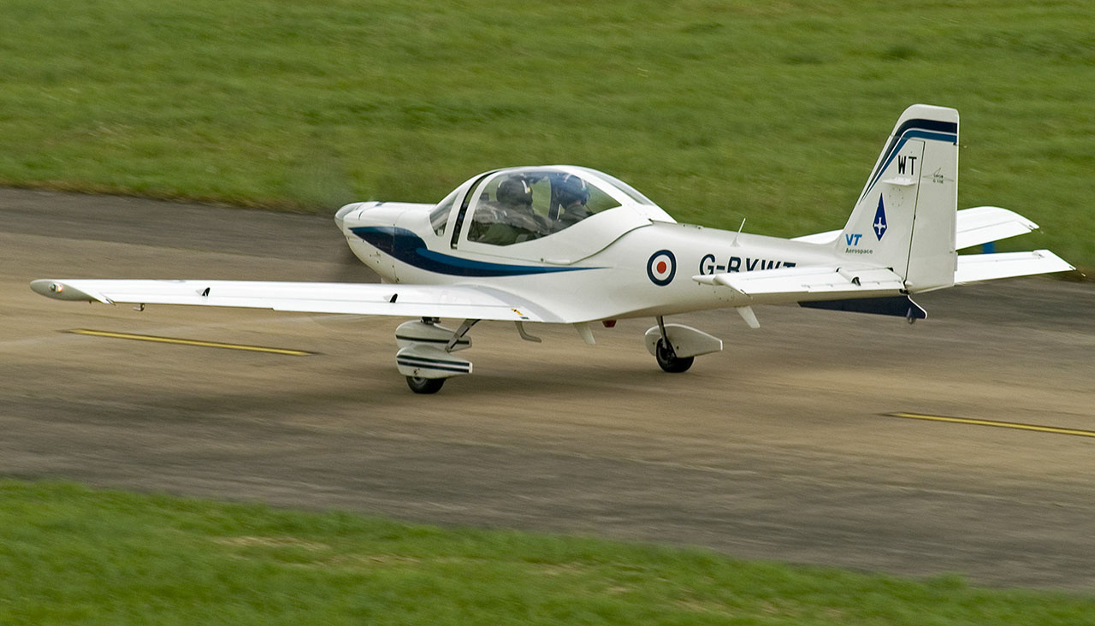
PASS
Control Surfaces – what do they look like in real life?
Rudder
Aileron
Elevator

Slide 17
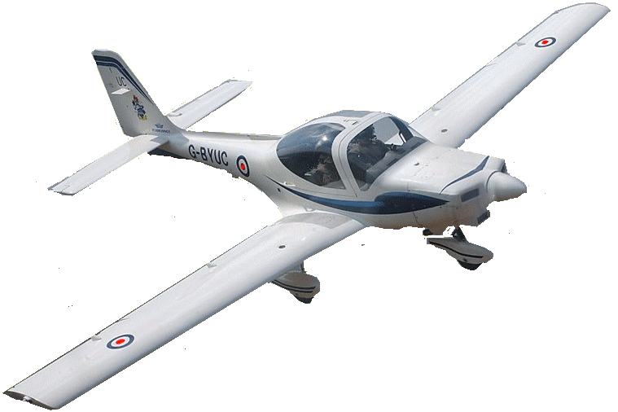
The Axes of an Aircraft
DISTINCTION

Slide 18
Longitudinal Axis – “roll”
DISTINCTION
Controlled by Ailerons

Slide 19
Vertical Axis – “yaw”
DISTINCTION
Controlled by
the Rudder

Slide 20
Lateral Axis – “pitch”
DISTINCTION
Controlled by Elevators

Slide 21
DISTINCTION
Ailerons

Slide 22
DISTINCTION
Control
column
Push right

Slide 23
DISTINCTION
Left aileron down
Right aileron up

Slide 24
DISTINCTION
Aircraft rolls right

Slide 25
DISTINCTION
Aircraft rolls right

Slide 26
DISTINCTION
Aircraft rolls right
And continues to do so until the
control column is placed
in the neutral position

Slide 27
Summary
DISTINCTION
Control column left
Left aileron up
Right aileron down
Aircraft rolls left

Slide 28
DISTINCTION
Rudder

Slide 29
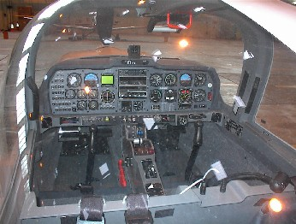
DISTINCTION
The rudder is controlled by
‘Rudder Pedals’ in the cockpit

Slide 30
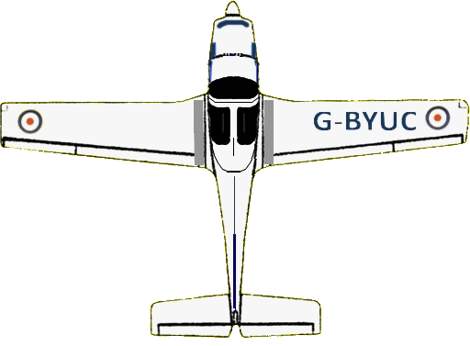
DISTINCTION
Rudder pedals
set to neutral

Slide 31
DISTINCTION
Push right pedal forwards
(left will come back towards you!)
Rudder moves
right

Slide 32
DISTINCTION
Aircraft yaws
right

Slide 33
DISTINCTION
Aircraft yaws
right

Slide 34
DISTINCTION
Aircraft yaws
right

Slide 35
Summary
DISTINCTION
Push right pedal forward
Rudder moves right
Aircraft moves right
Push left pedal forward
Rudder moves left
Aircraft moves left

Slide 36
DISTINCTION
Elevator

Slide 37
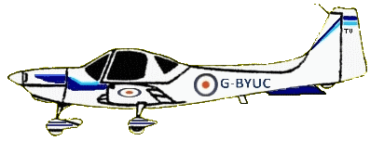
DISTINCTION
Control
column
Push
Forward

Slide 38
DISTINCTION
Elevator
moves
down

Slide 39
DISTINCTION
Nose
pitches down

Slide 40
DISTINCTION
Nose
pitches down

Slide 41
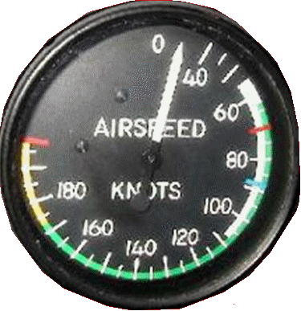
DISTINCTION
And continues to do so until the
control column is placed
in a neutral position
Airspeed will
increase
Nose
pitches down

Slide 42
Summary
DISTINCTION
Control column back
Elevator moves up
Nose pitches up
Speed will decrease

Slide 43
Practical Activities
Undertake the practical activities found in Ultilearn and record their completion in the First Class Cadet Logbook.
and
Demonstrate and practice on a flight simulator, if you have one.

