Slide 1
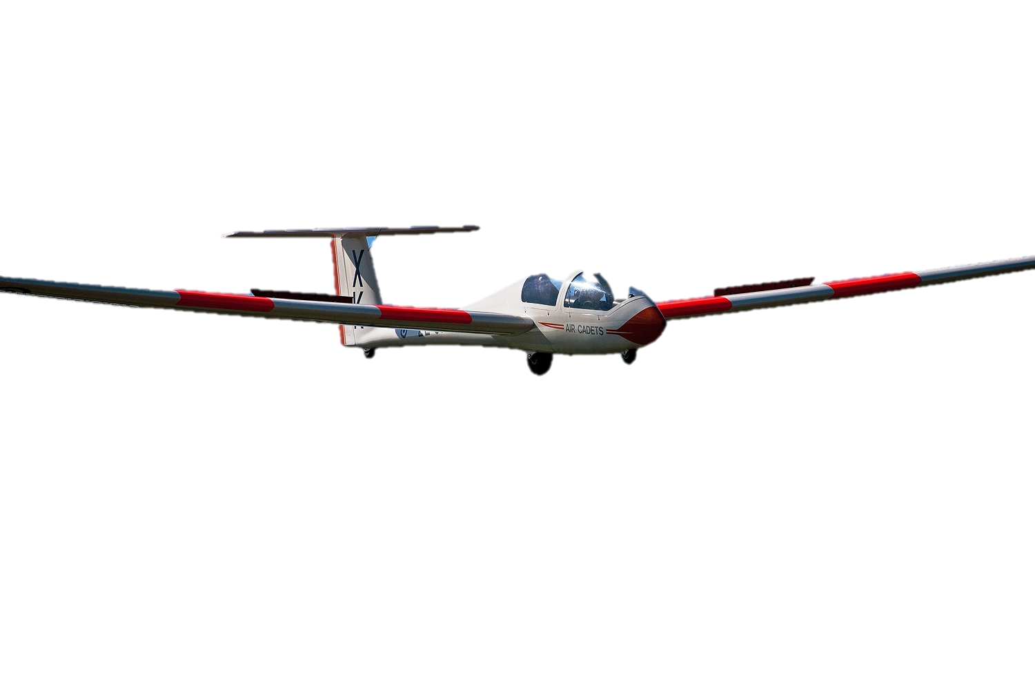
Fundamental Principles of Airmanship
Learning Outcome 1: Know the Features of an Airfield
Version 2 (May 19)

Slide 2
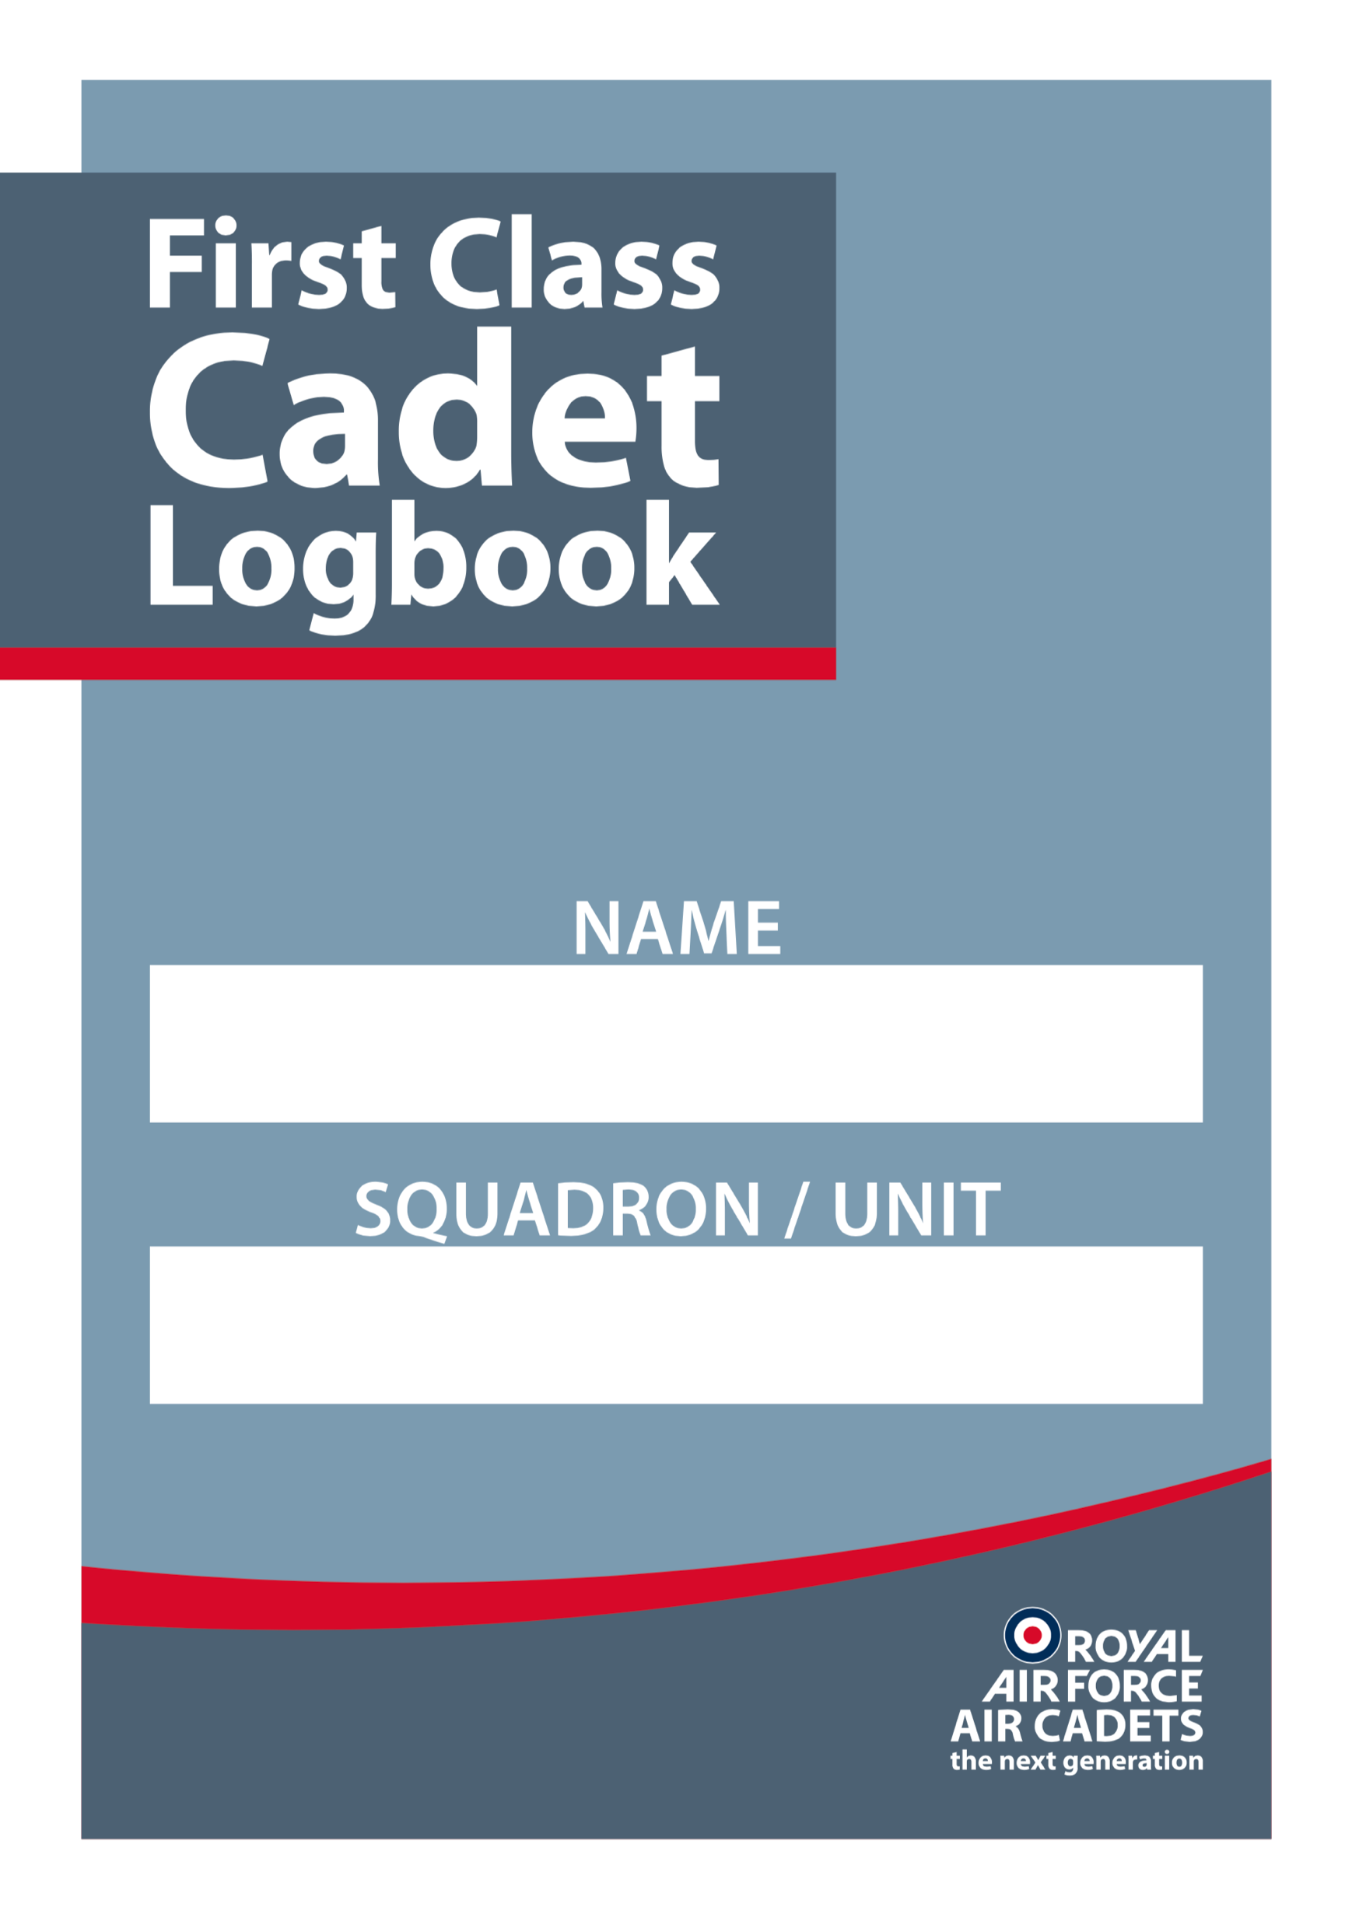
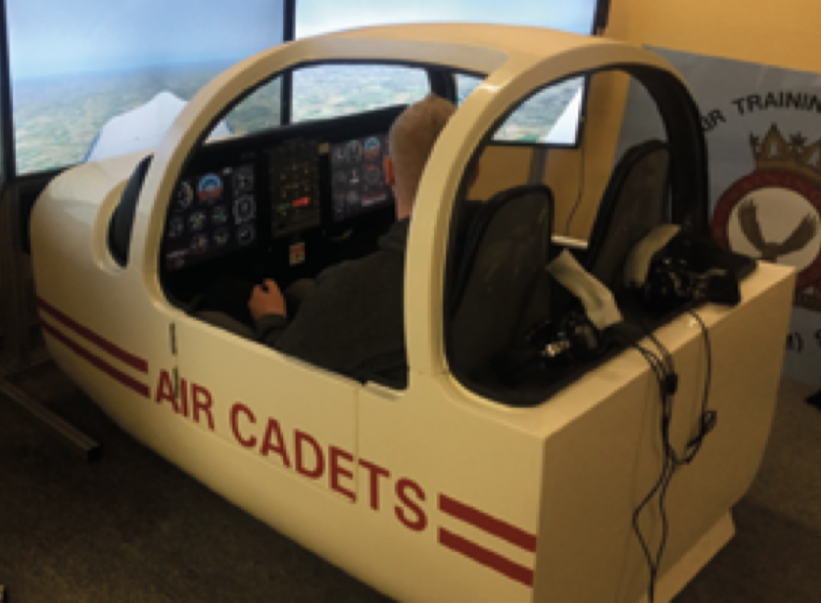
Practical Activities
Undertake the practical activities found in Ultilearn and record their completion in the First Class Cadet Logbook.
and
Demonstrate what the features of an airfield look like and what they do on a flight simulator, if you have one. Then practice using them.

Slide 3
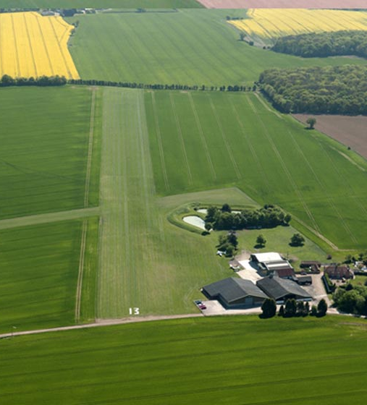
Basic Grass Airfield
PASS
Mainly used by light aircraft
It can offer a range of take-off directions
Making it easier to point into wind
It can be a bumpy ride!
Uneven terrain
Difficult to maintain
It can be difficult to control aircraft in cross-winds
Limits take-off conditions

Slide 4
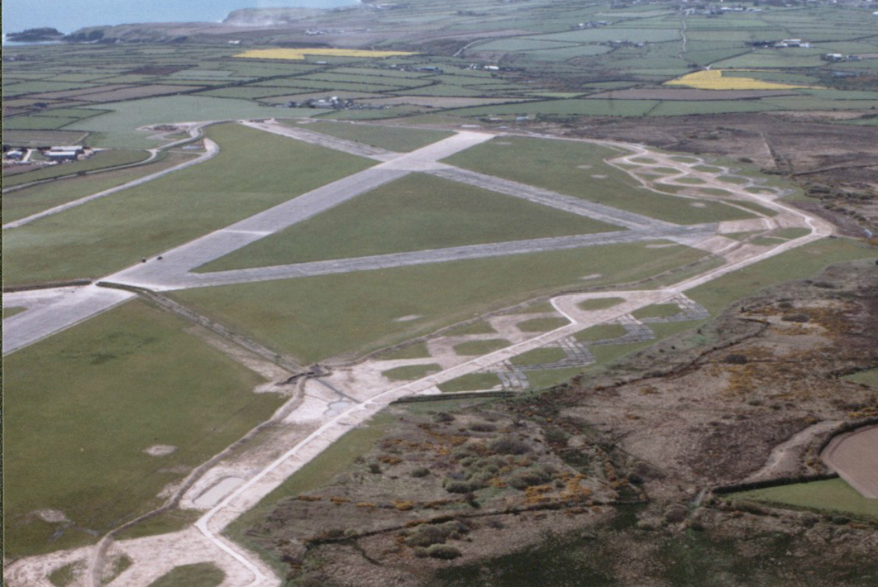
Triangular Patterned Runway
PASS
These can be used by heavier and faster aircraft
Triangle pattern gives a pilot choice of take-off and landing direction
Minimise cross-wind issues
Some runways become disused
Is more dependant on wind direction than a grass runway

Slide 5
Types of Airfield
PASS
What are the advantages and disadvantages of:
Grass airfields?
Advantages:
Cheap to build.
Disadvantages:
No designated runway so can take-off in any direction.
Susceptible to wet weather, aircraft can bog down.
Would not normally support large aircraft.
Triangle pattern airfields?
Advantages:
Built to a stronger datum, so large aircraft can use it.
Has three runway directions, so into wind is no problem.
Easier to control aircraft on the ground as there are
designated taxiways.
Disadvantages:
More costly to build.
Harder to repair if attacked.
Notes:
Summarise

Slide 6
Modern Main Instrument Runway
PASS
For aircraft that are heavier and require faster take off speeds
Usually one long, main runway
At major airports there may be multiple runways to speed up departure and arrivals
Has many landing aids, meaning can be used in poor weather
Faster speeds mean less cross-wind effects
Only really allows high performance aircraft and instrument landings
Small aircraft aren’t allowed

Slide 7
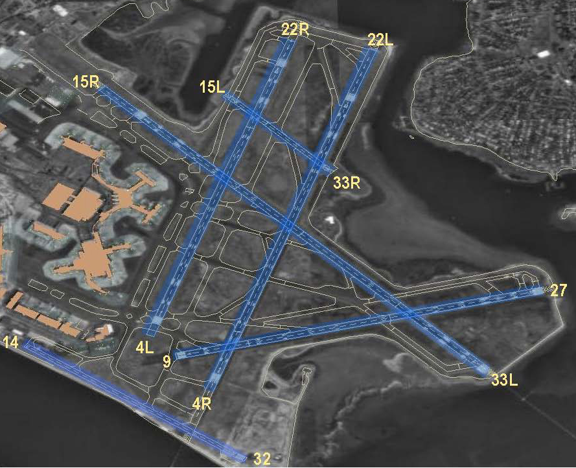
PASS
Major Airport
Logan
International
Boston, USA.
Notes:
Major airports may have multiple runways with often airliners taking off and landing simultaneously (on adjacent different runways).

Slide 8
Features of an Airfield
PASS
2. Operational Readiness Platform
1. Dispersal Hard Standing
18. Arrester Gear
15. Aerodrome Identification Beacon
3. Barrier
14. Holding Points
17. Windsock
20
4. Main Instrument Runway
12
19. Control Tower
13. Arrester Gear
SY
02
5. Hangar
30
7.Terminal Building
12. Barrier
9. Hangar
6. Aircraft Servicing Platform
11. Second Runway
10. Sterile Area

Slide 9
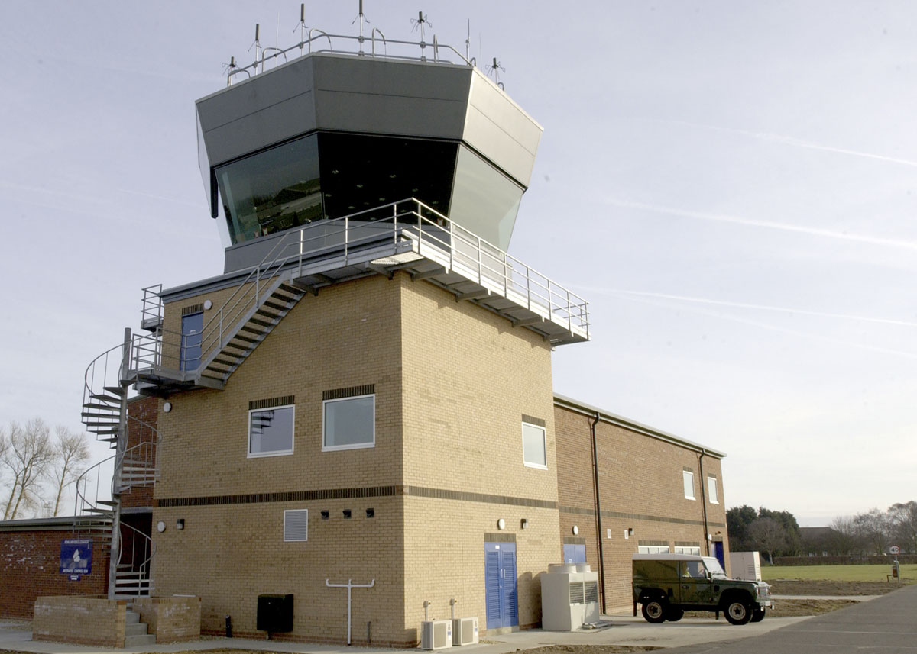
PASS
Control Tower
A building centrally located on the airfield with good visibility of the whole airfield
and the airspace around the airfield.
The control tower houses various controllers who control all aircraft, vehicular
and pedestrian traffic.
It also houses the communications and radar equipment used by the airfield.

Slide 10
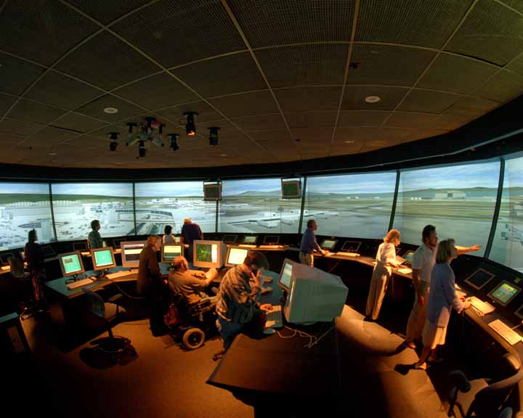
PASS
Air Traffic Control
Notes:
Local ATC controls all movements on the airfield.
ATC tower in prominent position to oversee airfield operations.
More in Vol 2 Airmanship II when a first class cadet!

Slide 11
PASS
Windsock
A visual aid to pilots to allow them to see what direction the wind is coming
from and to give an idea of the strength of the wind.
Most windsocks when the wind has blown them horizontal indicate that the
wind is 25 knots or greater.

Slide 12
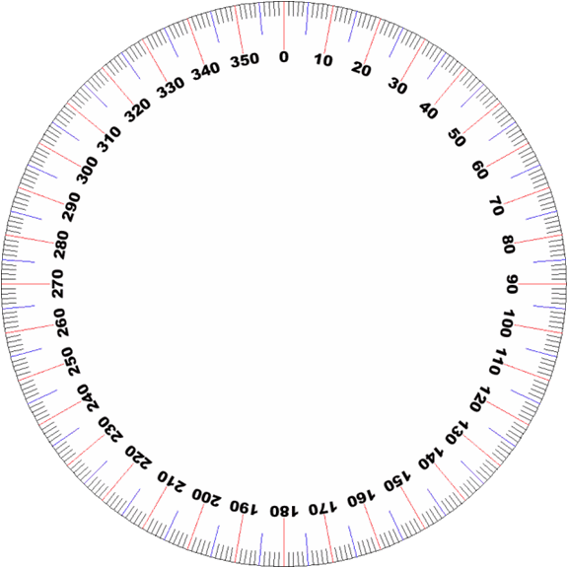
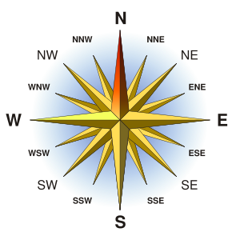
PASS
Runways numbered by Magnetic Compass Bearing
Notes:
Explain compass… link to map reading lessons.
Explanation of magnetic variation.
Early aircraft used Direct Indicating (DI) compass (similar to that used by hikers) which gave magnetic heading thus runways were measured in degrees magnetic.
More on this in Air Navigation for senior cadet.

Slide 13
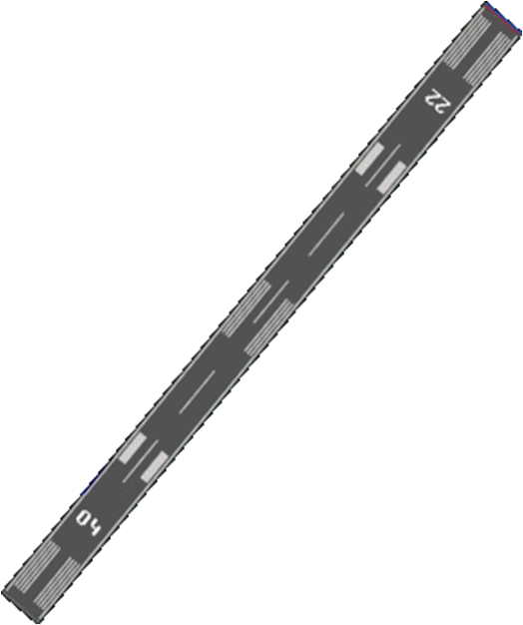
PASS
Runway 22 heading South West
Runway 04 (Reciprocal) heading North East
Notes:
Reciprocal = 180 degrees (opposite direction).

Slide 14
Runway Markings
MERIT
The lines on a runway all mean something!
Runway Number
This shows the magnetic heading of the runway – and helps the pilot see which runway to use
26
Threshold Markings
Clearly shows where the start of the runway is – and from where the aircraft can begin take-off or landing

Slide 15
Runway Markings
MERIT
The lines on a runway all mean something!
Displacement Markings
These show a pilot where they can take off from but shouldn’t land. For landing the threshold would be moved up the runway, this might be to avoid an obstruction
26
Side Stripe Markings
This solid line marks the outside edge of the runway

Slide 16
Runway Markings
MERIT
The lines on a runway all mean something!
Taxi Way
Yellow line to direct aircraft on and off of the runway
26
Centre Line
Broken white line showing the centre of the runway

Slide 17
Runway & Taxiway Markings
MERIT
Runways marked in white
Taxiways marked in yellow

Slide 18
Runway Lighting
MERIT
At night it’s hard to see the painted lines… so there’s a pattern of lights to help!
Here’s how to translate them…

Slide 19
Runway Lighting
MERIT
Edge of the Runway
Marked in White
Helps aircraft stay on the runaway whilst moving in the dark
Precision Approach Path Indicator Lights (PAPI)
Marked in White and Red
Helps pilot to line up on runway – it shows pilot if on the right glide path:
Too high
High
Just Right
Low
Too Low

Slide 20
Runway Lighting
MERIT
Threshold Lights
Marked in Green
High visibility line to mark where the runway starts
Centreline T
Marked in White and Red
High visibility T to mark the centre line.
These lights will be on in poor daytime conditions too
Approach Lights
Marked in White
Uni-directional lights to help pilot judge height and to line up with the runway

Slide 21
Airfield Design… what do you think?
DISTINCTION
What strengths do the different airfields have over one another?
Consider:
Layout
Size
Ground condition
Markings
Types of aircraft that can use them
Instruments or no instruments?
Safety of using each type
Importance of lights?

Slide 22
Airfield Design… what do you think?
DISTINCTION
What weaknesses do the different airfields have over one another?
Consider:
Layout
Size
Ground condition
Markings
Types of aircraft that can use them
Instruments or no instruments?
Safety of using each type
Importance of lights?

Slide 23
Practical Activities
Undertake the practical activities found in Ultilearn and record their completion in the First Class Cadet Logbook.
and
Demonstrate what the features of an airfield look like and what they do on a flight simulator, if you have one. Then practice using them.

