Slide 1
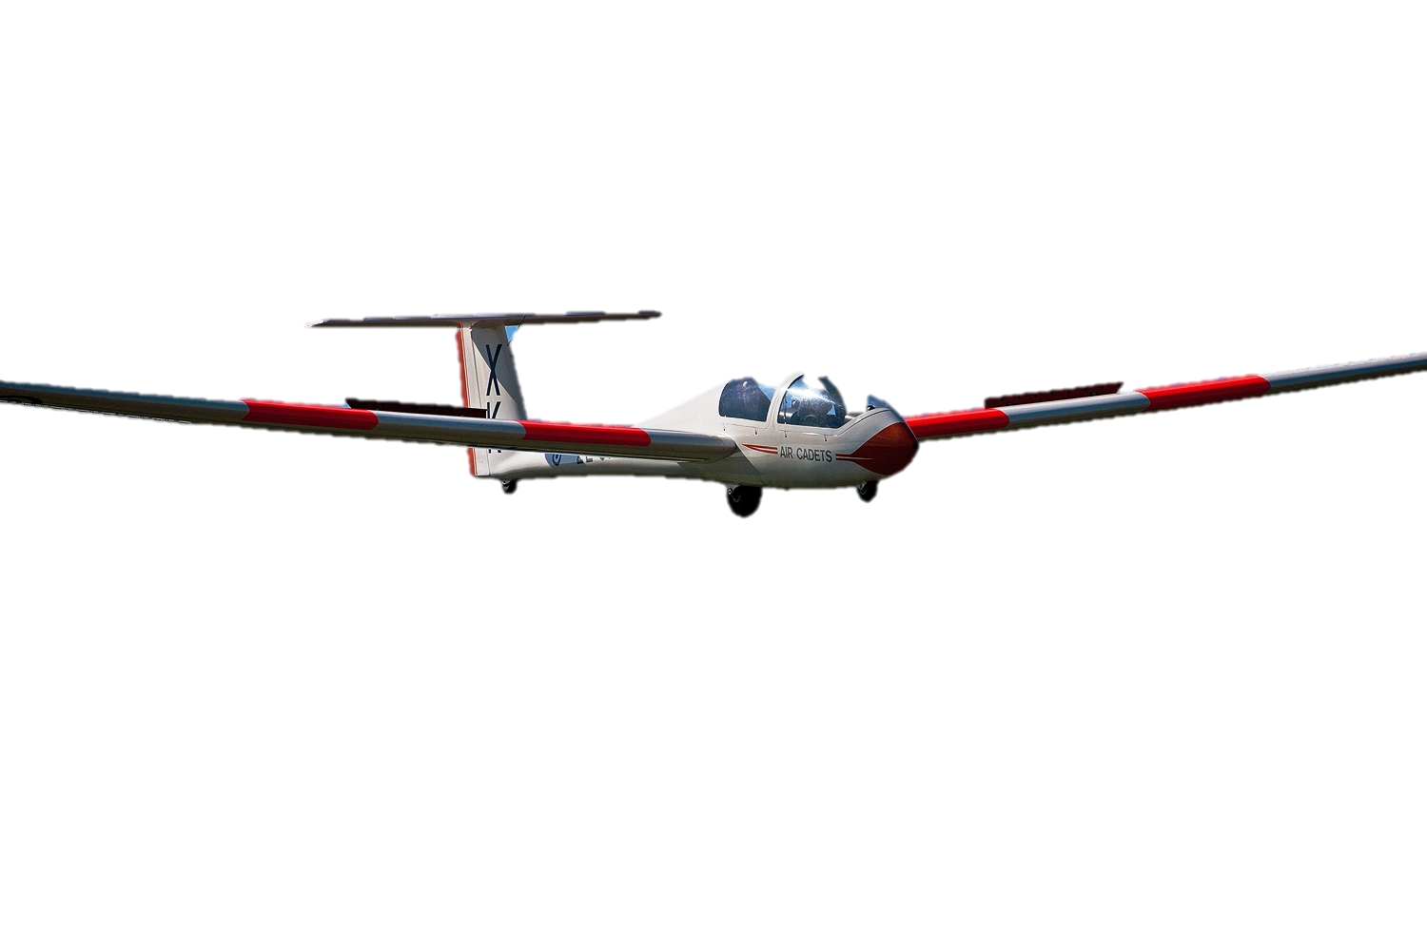
Fundamental Principles of Airmanship
Learning Outcome 3 (Part): Know the Features and Types of Aircraft Used for Air Cadet Flying
GLIDING
Version 2 (May 19)

Slide 2
Fundamental Principles of Airmanship
Learning Outcome 4: Know Processes Used to Launch Gliders and Maintain Flight
GLIDING
Version 2 (May 19)

Slide 3
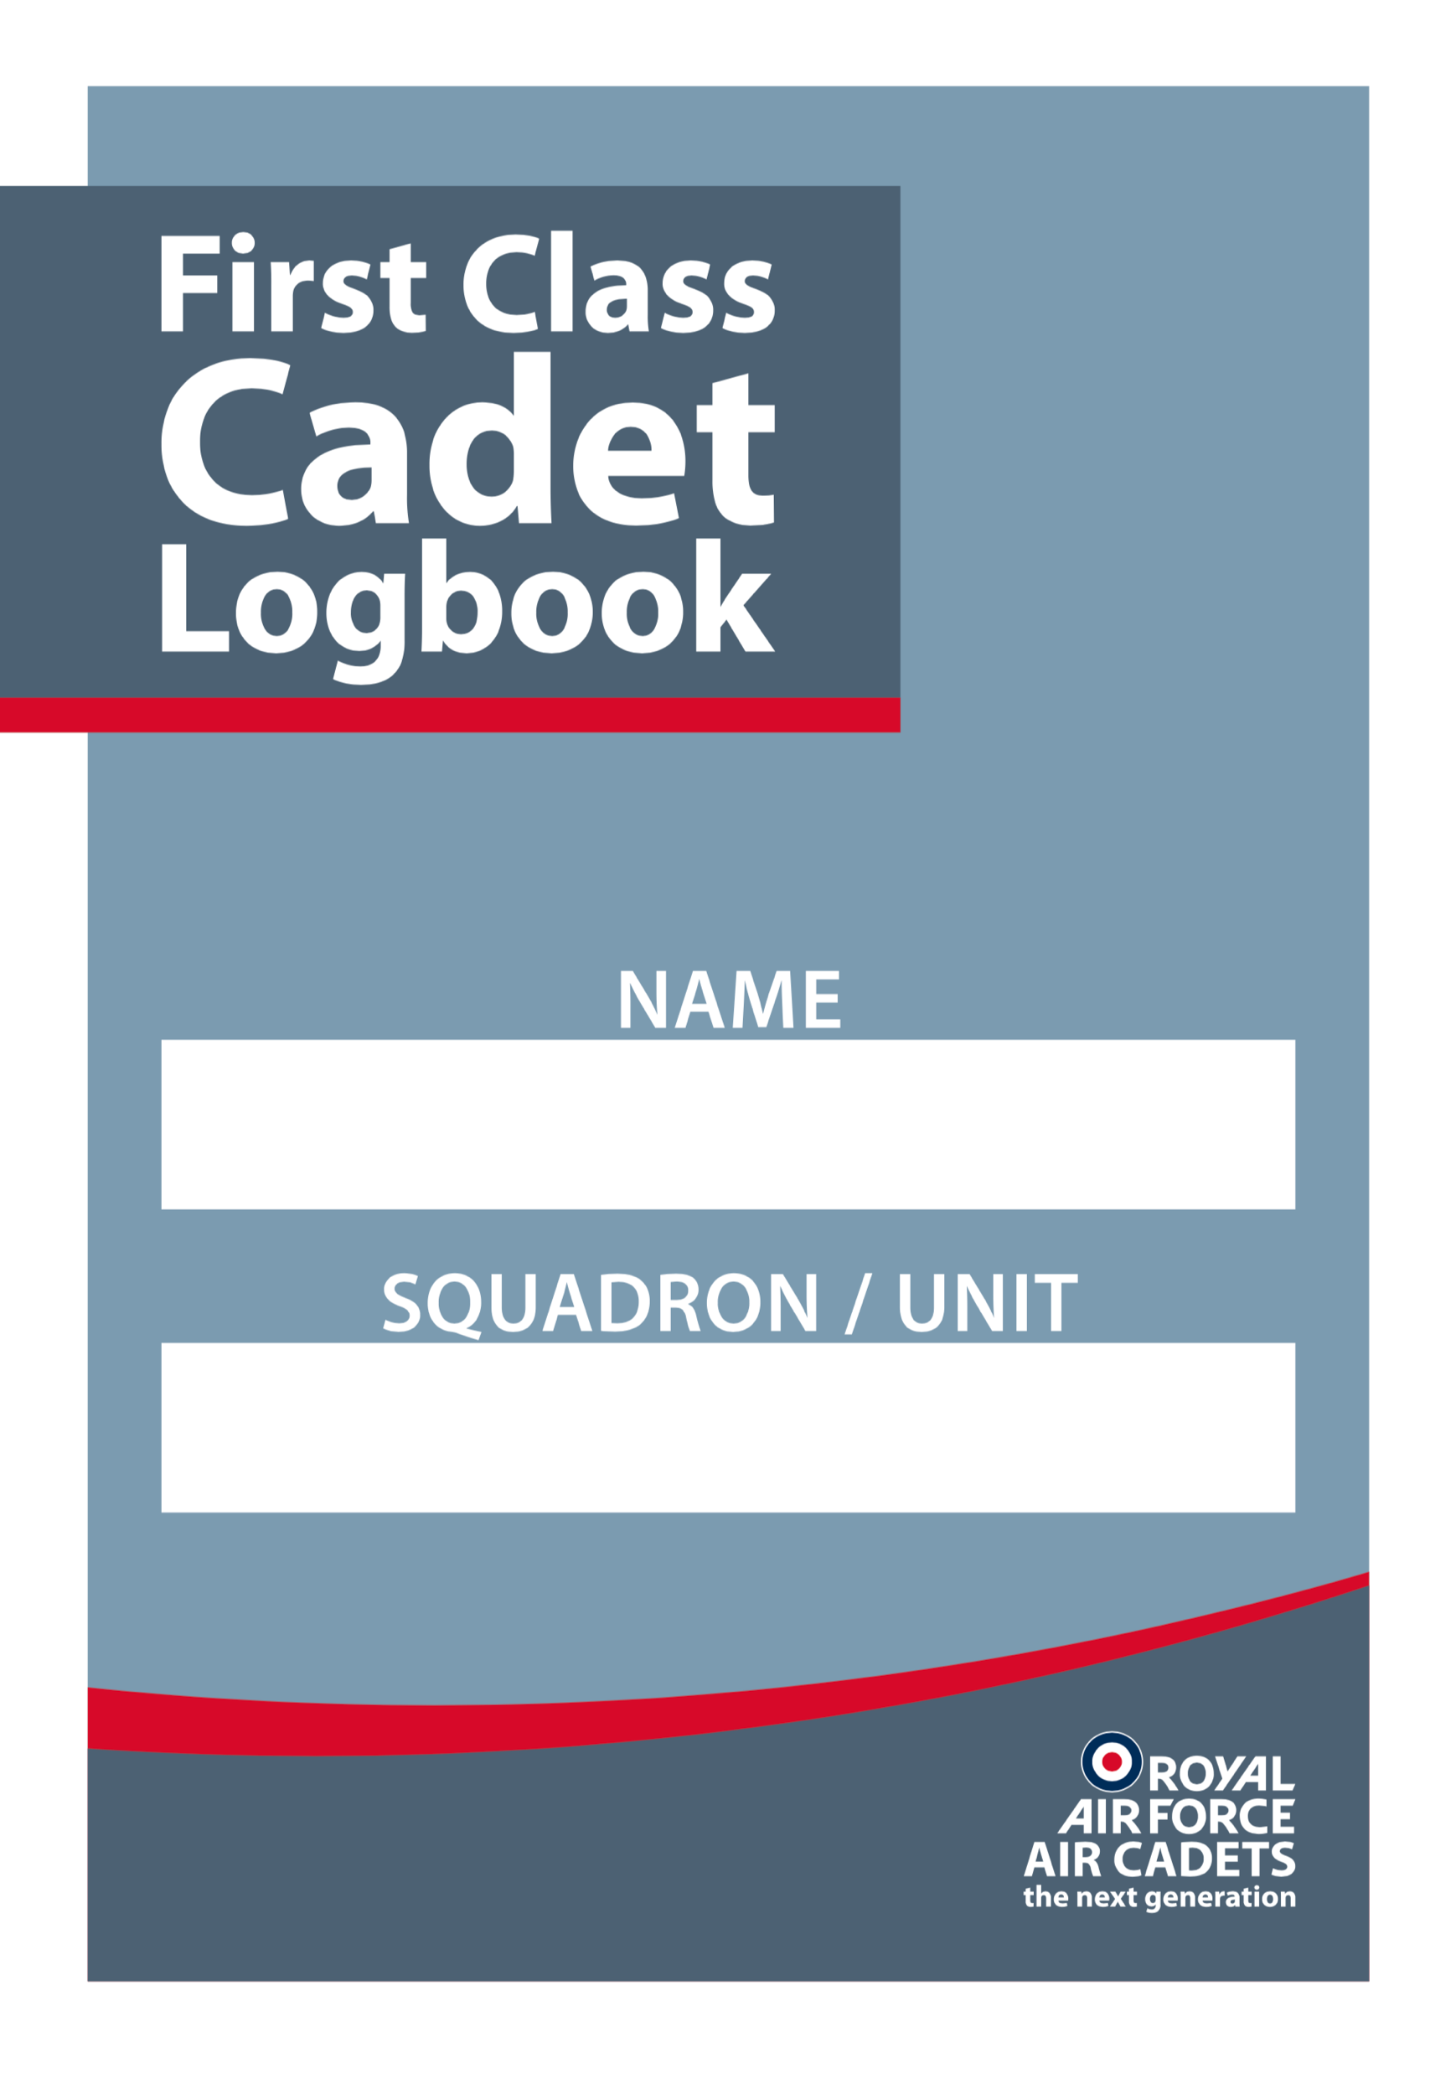
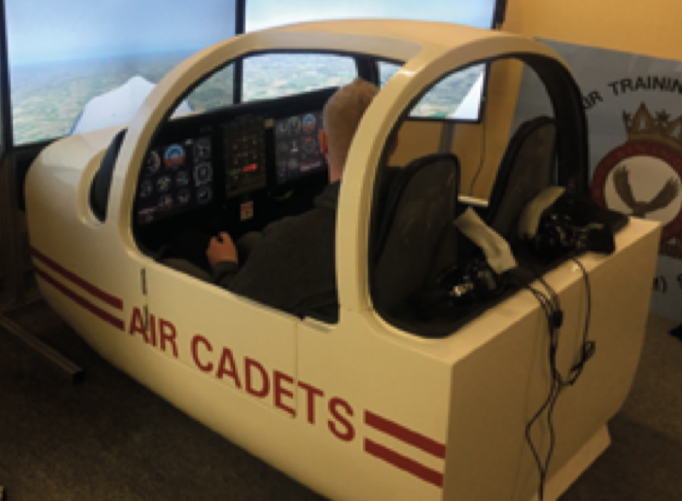
Practical Activities
Undertake the practical activities found in Ultilearn and record their completion in the First Class Cadet Logbook.
and
Demonstrate and practice on a flight simulator, if you have one.

Slide 4
Objectives
Know the glider used by the RAFAC
Describe 2 methods of launch
Know the stages of gliding training
Understand the principles of soaring
Understand the effects of the controls

Slide 5
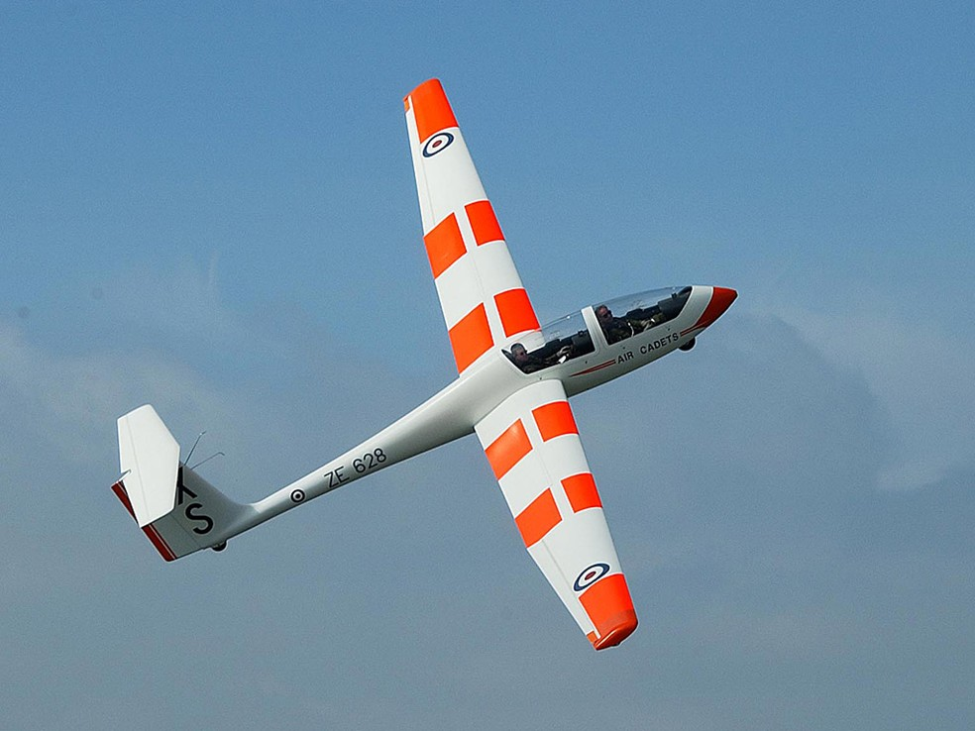
PASS
Viking - A Conventional Glider
Notes:
Viking – Conventional Glider
The backbone of the winch-launched fleet is the Viking two-seater, used for both basic and advanced cadet training. The aircraft are of glass reinforced plastic (GRP) construction. The Viking is a two-seater and has side-by-side tandem seating for the crew with dual controls, the instructor normally occupies the rear seat.
Controls
A glider’s controls and control surfaces are like those of a conventional aircraft. In other words, a glider is controlled by the coordinated movement of the elevators, ailerons and rudder, which the pilot operates through the control column and the rudder pedals, just as in the Tutor. In addition, winch launched gliders have:
a. A yellow toggle which the pilot pulls to release the cable when the glider has reached the top of the launch.
b. A lever to operate the airbrakes.

Slide 6
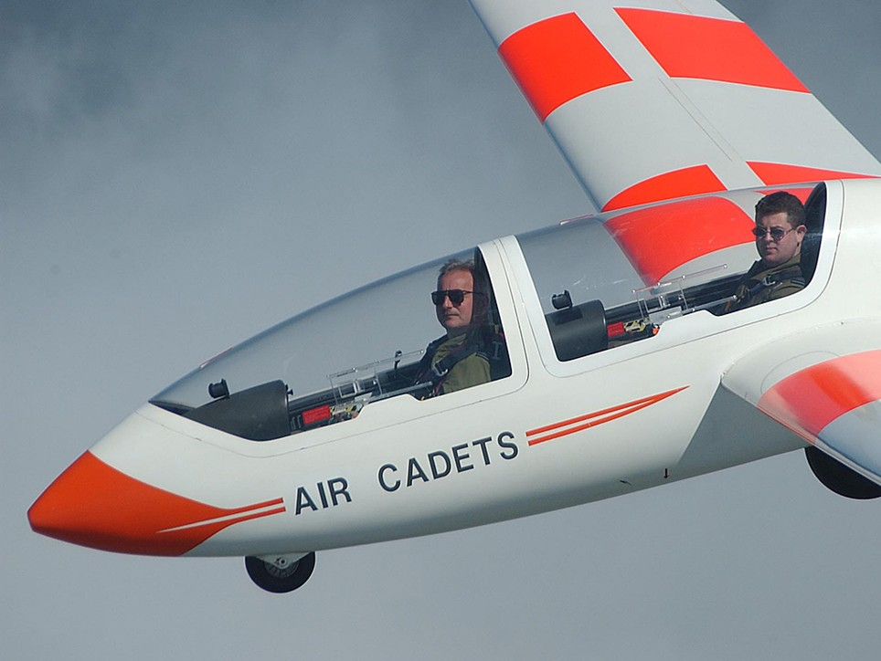
Tandem seats
The cadet sits in the front

Slide 7
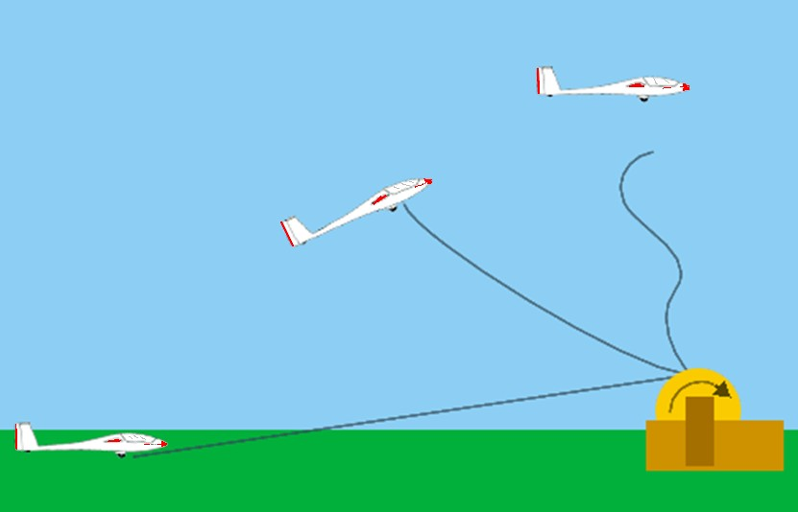
Winch Launch
PASS
Notes:
Since a glider has no engine it must be accelerated to its flying speed in some other way.
One method is using the Winched Launched method. A winch is a drum on which is wound about 1,500 metres of strong, flexible steel cable. The drum is turned by a powerful engine which the winch driver controls through an automatic gearbox.
The winch is normally sited close to the upwind boundary of the airfield. The cable is attached to the rear of a motor vehicle and drawn out to the launch point at the other end of the airfield, downwind of the winch. When the pilot is ready the cable is attached to the glider. The pilot checks there is no hazard from behind, by asking the wing tip holder “ALL CLEAR ABOVE AND BEHIND?” and calls “TAKE UP SLACK”. This instruction is passed to the winch driver by a signaller using either lamp signals or large bats. On receiving the signal the winch driver slowly reels in the cable until it is taut. When the pilot is satisfied that the slack has been taken up the order “ALL OUT” is given. The signaller signals this to the winch driver who then opens the winch throttle to wind the cable in. The cable pulls the glider forward and after a short distance it becomes airborne. Initially the glider climbs gently, but the attitude quickly steepens and height is gained rapidly. When the cable is about 70° to the horizontal, the pilot releases it and is then free to commence the gliding exercise.
When released, the cable falls to earth, steadied by a small parachute. It is then reeled in by the winch driver ready for the next launch. The height achieved from a winch launch varies with wind strength, the speed at which the cable is being wound onto the drum, and the length of cable being used. However, as a rough estimate the height gained is usually about one third of the cable length being used (eg 1,000 metres of cable gives a launch height of 1,000 feet). A winch launched flight normally lasts for 6-10 minutes, giving the pilot ample time to complete some exercises and a standard circuit of the airfield.

Slide 8
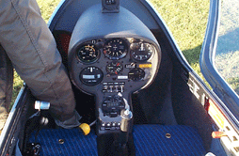
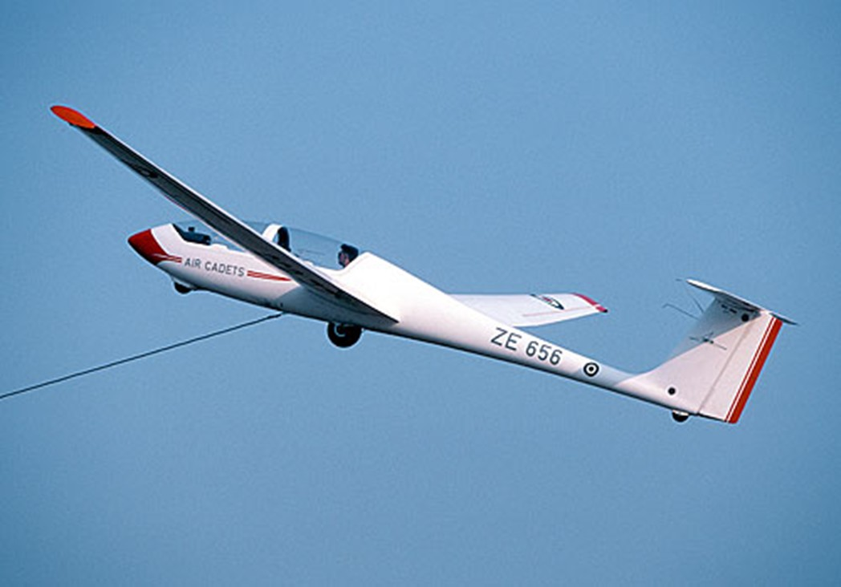
PASS
Cable release

Slide 9
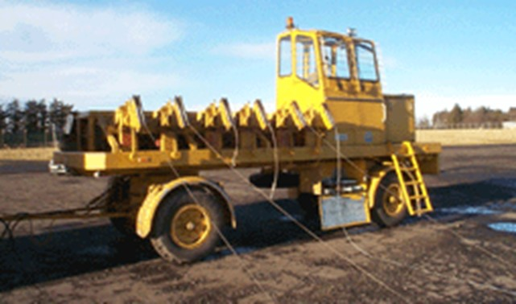
PASS
Winch
Notes:
Winch launcher

Slide 10
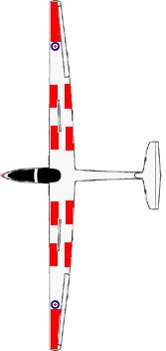
PASS
Attach outermost
cable to glider
Viking
Launch
control
Winch
vehicle
Retrieval
vehicle
Notes:
Layout of a Viking based Volunteer Gliding Squadron

Slide 11
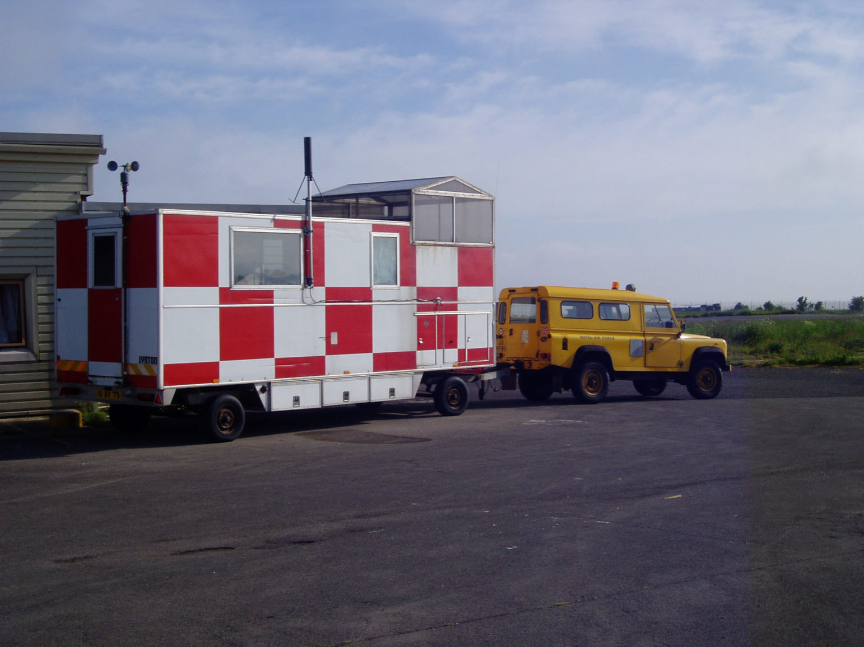
PASS
Launch Caravan
Notes:
Gliding Launch Caravan

Slide 12
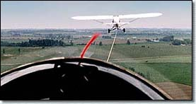
PASS
Aero Tow
Notes:
One method is aerotowing – whereby a powered aircraft pulls a glider off the ground and up to a pre-determined height by means of a towing cable. However, the opportunity for this is rare, and only available through Air Cadets Central Gliding School.

Slide 13
MERIT
Viking – Instrument panel
Notes:
Flight Instruments
Although the glider is normally flown by visual reference to the horizon, four flight instruments are fitted for accuracy. Three of these, the airspeed indicator, the altimeter and the turn and slip indicator function similarly to those fitted in the Tutor. However, the fourth (the Variometer) is specific to gliders.

Slide 14
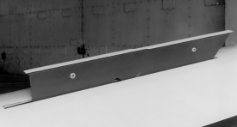
MERIT
Airbrakes
Notes:
Airbrakes
There are various types of airbrake. Those on Air Cadet gliders are panels which extend upwards from the top surface of the wing. When retracted within the wing the top edge lies flush with the wing surface. When extended they increase the drag and reduce the lift, allowing the glider to descend more quickly without increasing the speed. This enables the pilot to land in a much smaller space than would otherwise be possible.

Slide 15
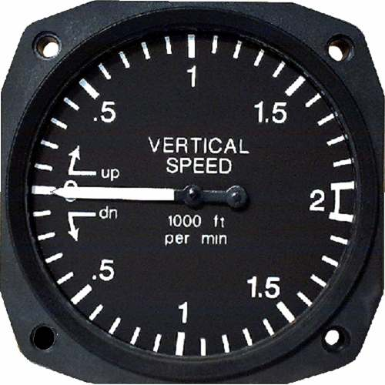
Vertical Speed Indicator
MERIT
Why is this important in a glider?
Notes:
The Vertical Speed Indicator’s (VSI) purpose is to indicate whether the glider is losing or gaining height. This is not quite as simple as it sounds, as a glider might at one moment be in still air, descending gradually to maintain flying speed, then the next moment it might encounter air which is rising fast enough to overcome that descent and make the glider gain height.
Equally, it might enter descending air which will increase the rate of descent. The VSI is invaluable in helping the pilot to find rising air, and to stay in it to prolong the flight. In fact, the Viking has 2 VSI, one of which indicates rising or descending air by means of audio tones from a loud speaker.

Slide 16
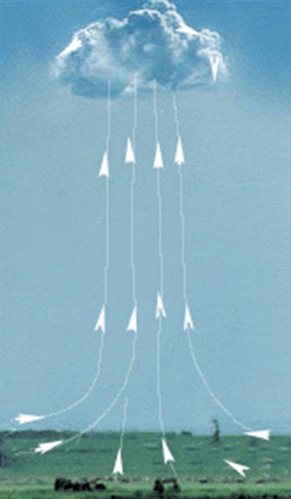
PASS
Thermal
Sunlight heats ground
Ground warms air
Warm air rises
Notes:
Soaring with Thermals
Soaring is the art of finding rising air and, then using it to gain height, thus prolonging the flight. For example, “thermals” caused by uneven heating of the earth are common on hot sunny days. Surfaces such as green fields, woods and lakes do not heat up as rapidly as concrete, tarmac, built up areas, sandy areas or dry fields. Thus concrete or tarmac areas will become much hotter than the surrounding green fields. The air over the concrete will therefore rise (like a hot air balloon); this rising air is called a thermal. Thermal activity is not continuous, the warm air being released in the form of bubbles which rise at intervals like invisible air balloons.

Slide 17
PASS
Forming thermals
Cumulus cloud formed by rising area
Cold air sinking
Sun’s Rays
Warm air rising
(thermals)
Wind
Concrete area of airfield
Notes:
If the rising air is moist, cumulus or heap type clouds will form which can give pilots a good idea of where thermals are forming. If thermal activity is suspected the pilot will keep an eye on the variometer and when he finds rising air the pilot will try to circle in it and gain height. Even with the aid of the variometer, it requires considerable skill and experience to get maximum use from thermals.

Slide 18
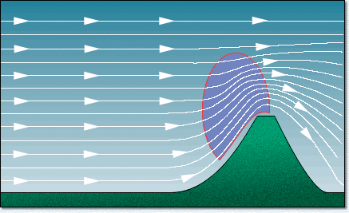
PASS
Using Up-Currents on Hills
Area of best lift
High ground forces moving air upwards
Notes:
Rising air can also be found on the windward side of hills. When the surface wind strikes the face of a hill or ridge it will be deflected upwards, becoming an upcurrent By staying in this rising air the pilot will be able to maintain or gain height, according to the strength of the up-current. Care must be taken not to fly the glider behind the ridge, as down-currents there would cause the glider to lose height rapidly.

Slide 19
PASS
Cross Country Gliding
Hopping from one thermal to another

Slide 20
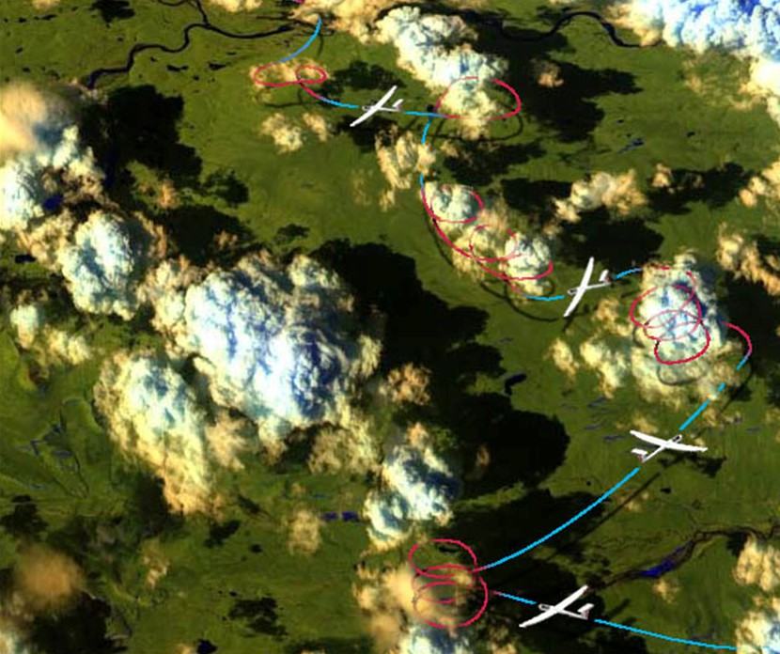
PASS
Cross Country Gliding
Notes:
Stress that cross country gliding is a specialised skill …must be aware of navigation and proximity of landing airfield.

Slide 21
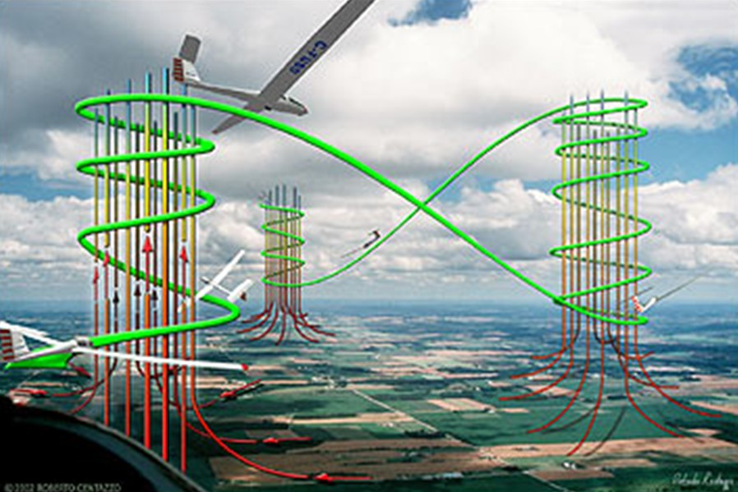
PASS
Cross Country Gliding
Notes:
Because thermals can be infrequent, many gliders can collect over them – as such it is important for both cadets & pilots to ensure a good lookout.

Slide 22
DISTINCTION
Aircraft Axes

Slide 23
Lateral Axis
DISTINCTION
PITCH

Slide 24
Longitudinal Axis
DISTINCTION
ROLL

Slide 25
Vertical Axis
DISTINCTION
YAW

Slide 26
DISTINCTION
Elevator

Slide 27
DISTINCTION
Control
column
forward

Slide 28
DISTINCTION
Elevator
moves
down

Slide 29
DISTINCTION
Elevator
moves
down
Nose pitches
down

Slide 30
DISTINCTION
Elevator
moves
down
Nose pitches
down
Airspeed will
increase

Slide 31
DISTINCTION
Elevator
moves
down
Nose pitches
down
Continues to do so until the control column is placed in a neutral position
Airspeed will
increase

Slide 32
Summary
DISTINCTION
Control column back
Elevator moves up
Nose pitches up
Airspeed will increase

Slide 33
DISTINCTION
Ailerons

Slide 34
DISTINCTION
Control column right

Slide 35
DISTINCTION
Left aileron down
Right aileron up

Slide 36
DISTINCTION
And continues to do so until the
control column is placed
in the neutral position
Aircraft rolls right

Slide 37
Summary
DISTINCTION
Control column left
Left aileron up
Right aileron down
Aircraft rolls left

Slide 38
DISTINCTION
Rudder

Slide 39
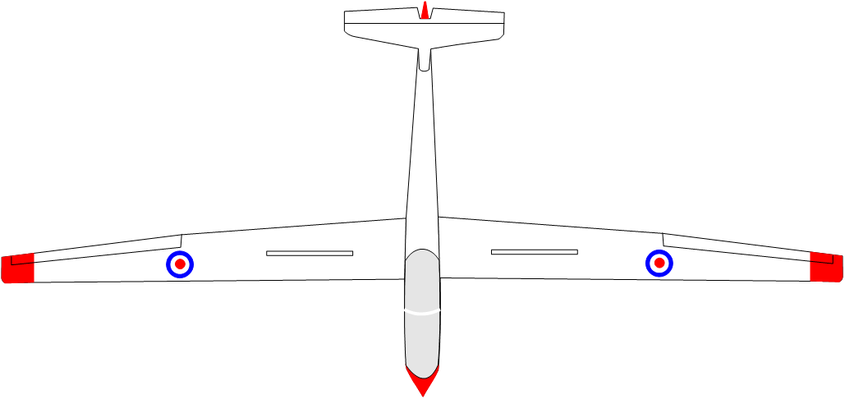
DISTINCTION
Right foot
forward

Slide 40
DISTINCTION
Right foot
forward
Rudder moves
right

Slide 41
DISTINCTION
Right foot
forward
Rudder moves
right
Aircraft yaws
right

Slide 42
Orders used to get gliding!
PASS
Once you’re sat in the Glider we need to know it’s safe to take off…
“All clear above and behind”
When the glider is completely ready and it is safe to launch, the pilot and wing tip holder check above and behind the glider to ensure there are no hazards

Slide 43
Orders used to get gliding!
PASS
When it’s been confirmed it’s clear…
“Take up Slack!”
The pilot indicates with one finger and gives the command “Take up slack”
The signaller passes this on to the winch driver using lamp signals or large bats
The winch driver pulls slack out of the cable

Slide 44
Orders used to get gliding!
PASS
Once the winch cable is nice and tight…
“All Out!”
The pilot indicates with two finger and gives the command “All out”
The signaller passes this on to the winch driver using lamp signals or large bats.
The winch speeds up and the glider begins ground ride and launch with the wing tip holder holding the wings level to begin with

Slide 45
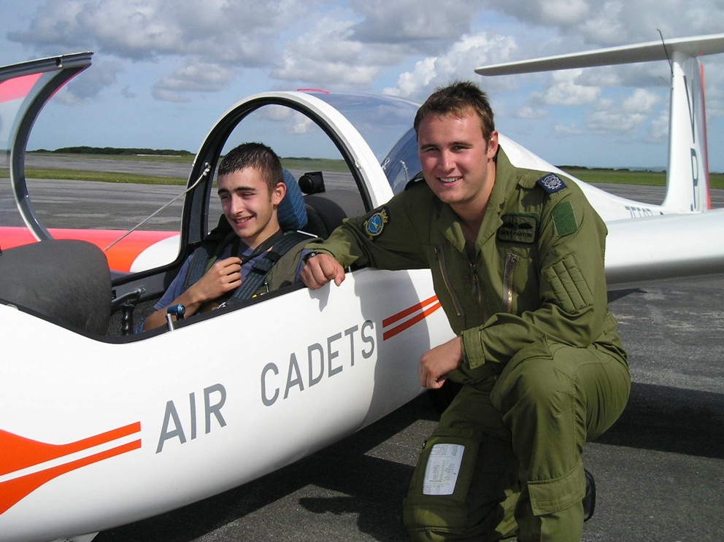
Solo Completed!

Slide 46
Cadet Gliding Wings
Blue Wings
Bronze Wings
Silver Wings
Gold Wings

Slide 47
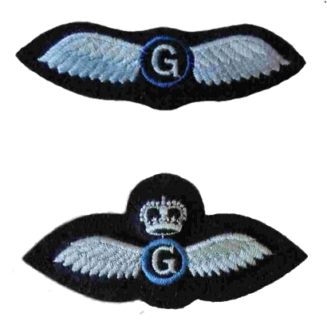
Gliding Instructor Badges
Gliding Instructor
(Grade 1/C Category Pilot)
Senior Gliding Instructor
(A & B Category Instructor)

Slide 48
Objectives
Know the glider used by the RAFAC
Describe 2 methods of launch
Know the stages of gliding training
Understand the principles of soaring
Understand the effects of the controls

Slide 49
Any Questions?

Slide 50
Questions
Name the glider used by the RAFAC

Slide 51
Questions
Name the glider used by the RAFAC
How is the glider launched?

Slide 52
Questions
Name the glider used by the RAFAC
How is the glider launched?
What is a thermal?

Slide 53
Questions
Name the glider used by the RAFAC
How is the glider launched?
What is a thermal?
How does a glider pilot use thermals?

Slide 54
What happens to the elevators if you move
the control column forwards?

Slide 55
Elevator
moves
down

Slide 56
Elevator
moves
down
Nose pitches
down

Slide 57
Elevator
moves
down
Nose pitches
down
Continues to do so until the control column is placed in a neutral position
Airspeed will
increase

Slide 58
What happens when you move the Control Column to the right?

Slide 59
Left aileron down
Right aileron up

Slide 60
And continues to do so until the
control column is placed
in the neutral position
Aircraft rolls right

Slide 61
Questions
What do these badges represent?

Slide 62
Practical Activities
Undertake the practical activities found in Ultilearn and record their completion in the First Class Cadet Logbook.
and
Demonstrate and practice on a flight simulator, if you have one.

